Slide 1
Computer Vision and Deep Learning
Lecture 10

Slide 2
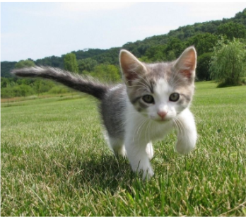
Object localization
What object is this image and where is this object located in the image?
CAT

Slide 3
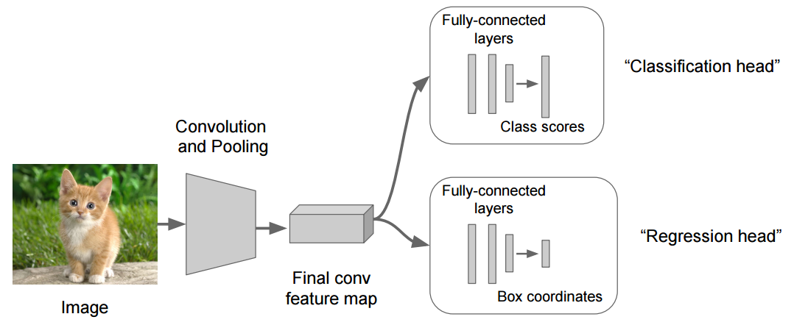
Object localization
Image source: https://leonardoaraujosantos.gitbook.io/artificial-inteligence/machine_learning/deep_learning/object_localization_and_detection

Slide 4
Object localization
C class scores
Softmax loss L_{s}
BBOX coordinates
4 outputs (x, y, w , h)
L2 loss L₂
Image source: https://leonardoaraujosantos.gitbook.io/artificial-inteligence/machine_learning/deep_learning/object_localization_and_detection

Slide 5
Object detection
Determine the class (label) and the position of EACH object in the input image
We can’t use the same approach as for localization
Each image would require a different number of outputs
Object detection challenges?
Sliding window approach?

Slide 6
Object detection challanges
Multiple outputs: Need to output variable numbers of objects per image
Multiple types of output: Need to predict ”what” (label) as well as “where” (bounding box)
Large images: Classification works at 224x224; need higher resolution for detection, often ~800x600

Slide 7
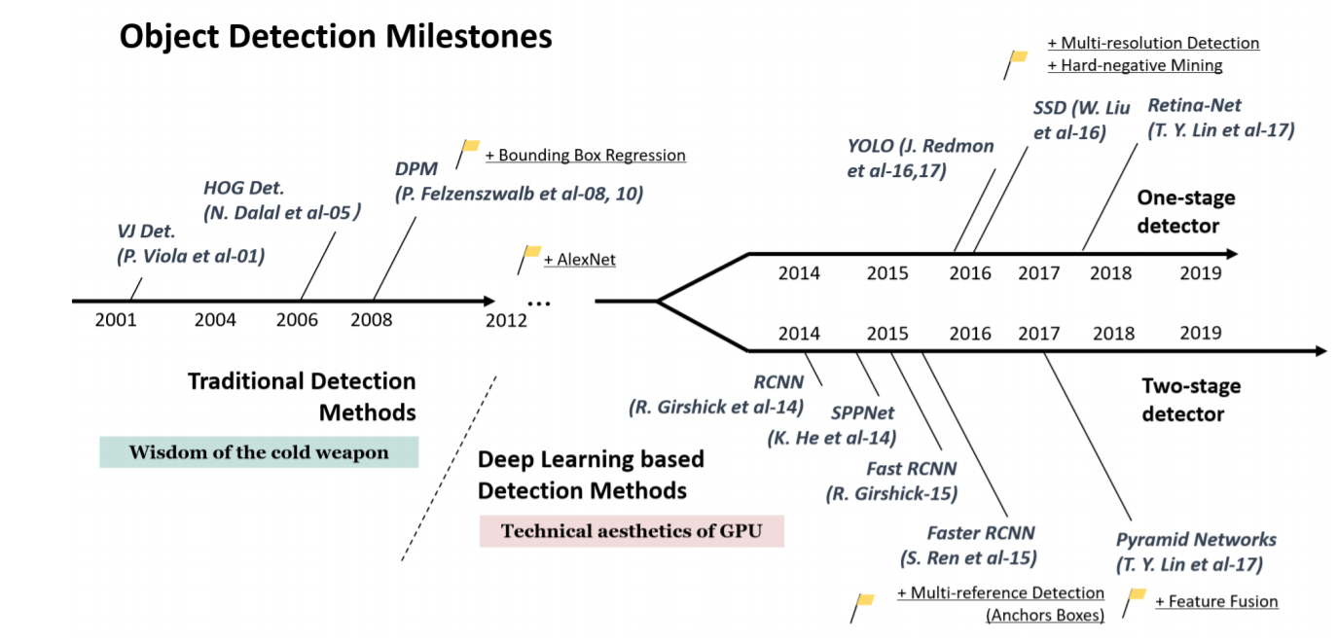
Object detectors
Object Detection in 20 Years: A Survey

Slide 8
Proposal based object detection

Slide 9
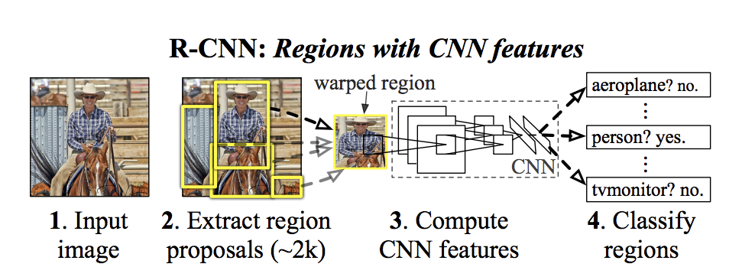
R-CNN Region-based Convolutional Network, 2014
Idea:
Use an algorithm (or network) to find region of interests (ROIs) that are likely to contain an object
Localize (label + bounding box) localize the object in each in region
https://arxiv.org/pdf/1311.2524.pdf

Slide 10
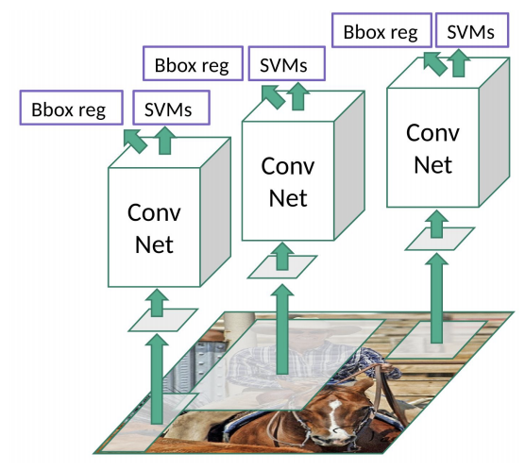
R-CNN Region-based Convolutional Network, 2014
Selective search to extract 2000 regions. NO learning here
Image source: https://towardsdatascience.com/r-cnn-fast-r-cnn-faster-r-cnn-yolo-object-detection-algorithms-36d53571365e

Slide 11
R-CNN Region-based Convolutional Network, 2014
Warp each image region into a square of 227x227 ROI (will be fed to AlexNet)
Selective search to extract 2000 regions. NO learning here
Image source: https://towardsdatascience.com/r-cnn-fast-r-cnn-faster-r-cnn-yolo-object-detection-algorithms-36d53571365e

Slide 12
R-CNN Region-based Convolutional Network, 2014
AlexNet – feature extractor
Warp each image region into a square of 227x227 ROI (will be fed to AlexNet)
Selective search to extract 2000 regions. NO learning here
Image source: https://towardsdatascience.com/r-cnn-fast-r-cnn-faster-r-cnn-yolo-object-detection-algorithms-36d53571365e

Slide 13
R-CNN Region-based Convolutional Network, 2014
SVMs to classify the presence + label of an object in region
Regression to fine tune the bounding boxes
AlexNet – feature extractor
Warp each image region into a square of 227x227 ROI (will be fed to AlexNet)
Selective search to extract 2000 regions. NO learning here
Image source: https://towardsdatascience.com/r-cnn-fast-r-cnn-faster-r-cnn-yolo-object-detection-algorithms-36d53571365e

Slide 14
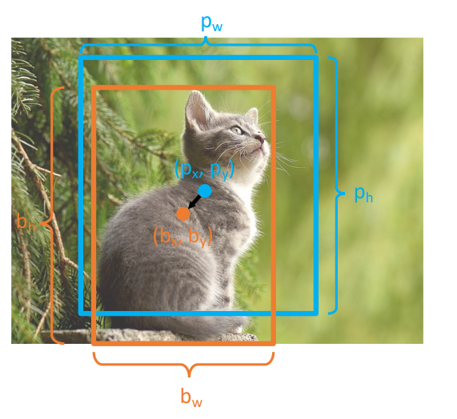
BBox regression
Consider a region proposal with center (px, py) and size (pw, ph)
RCNN predicts a transform (tx, ty, tw, th) to correct the region proposal

Slide 15
BBox regression
Ouput bbox:
bx = px + pw·tx
by = py + ph·ty
bw = pw · exp(tw)
bh = ph · exp(th)
The position is shifted by an amount relative to proposal size
Scale the size; exp ensures that scaling factor is > 0
The transform encodes relative difference between proposal and output (CNN doesn’t see absolute size or position after cropping)

Slide 16
BBox regression
Ouput bbox:
bx = px + pw·tx
by = py + ph·ty
bw = pw · exp(tw)
bh = ph · exp(th)
Solving for the transform given the proposal and target:
tx = (bx - px)/pw
ty = (by - py)/ph
tw = log(bw/pw)
th = log(bh/ph)

Slide 17
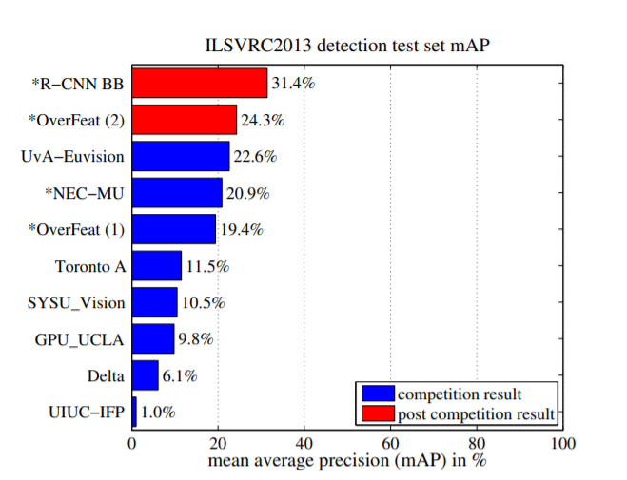
R-CNN
Running time: “13s/image on a GPU or 53s/image on a CPU”

Slide 18
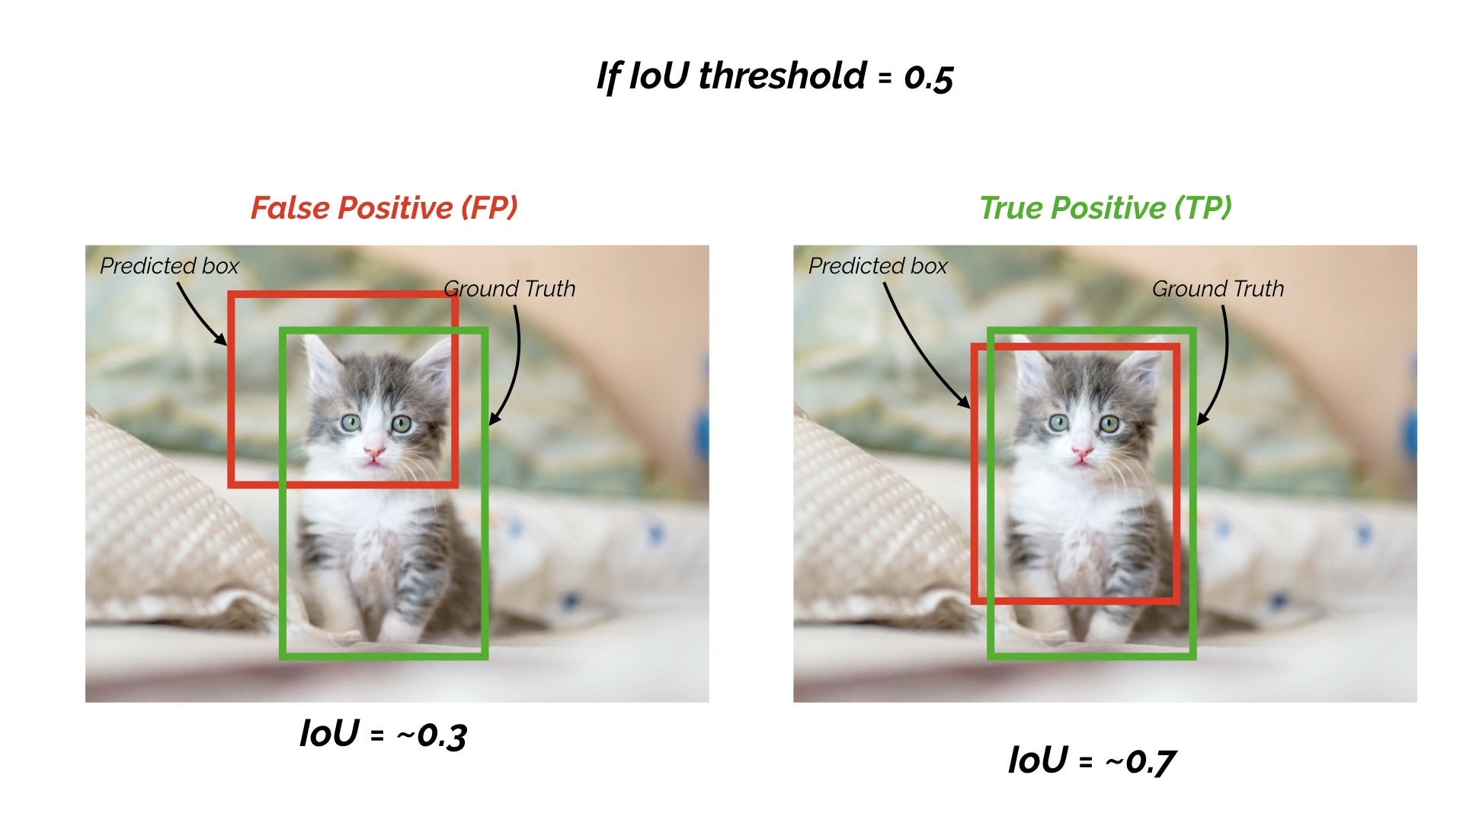
IoU > 0.5 – decent
IoU > 0.7 - acceptable
Iou > 0.9 – almost perfect

Slide 19
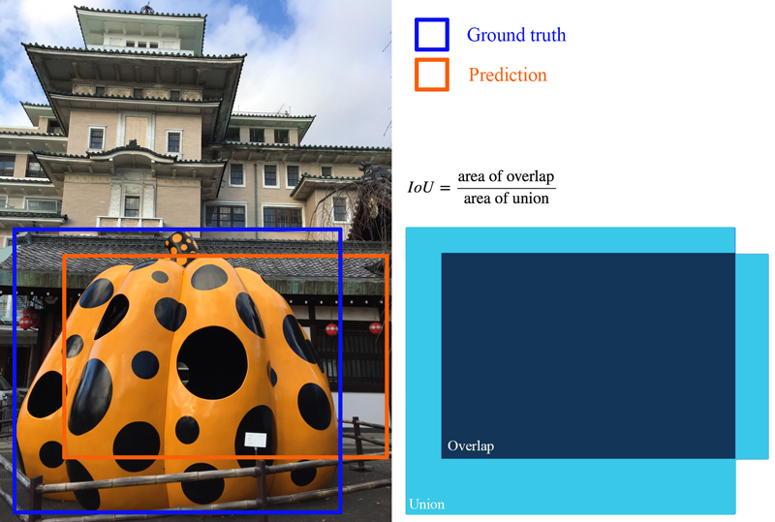
Evaluation metrics for object detection
Use IOU to determine is the object is a TP, FP, or a FN
Remember precision and recall?
Images and notes from: https://jonathan-hui.medium.com/map-mean-average-precision-for-object-detection-45c121a31173

Slide 20
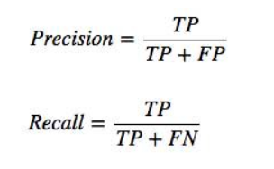
Evaluation metrics for object detection
Use IOU and a threshold to determine is the object is a TP, FP, or a FN
Remember precision and recall?
Images and notes from: https://jonathan-hui.medium.com/map-mean-average-precision-for-object-detection-45c121a31173

Slide 21
mAP
Run object detector on all test
For each category, compute Average Precision (AP) = area under Precision vs Recall Curve
For each detection (sorted from highest score to lowest score)
If it matches a GT box with IoU > threshold, mark it as positive and eliminate the GT
Else mark it as negative
Compute precision and recall
Add a point on the PR Curve
Average Precision (AP) = area under PR curve
Mean Average Precision (mAP) = average of AP for each category

Slide 22
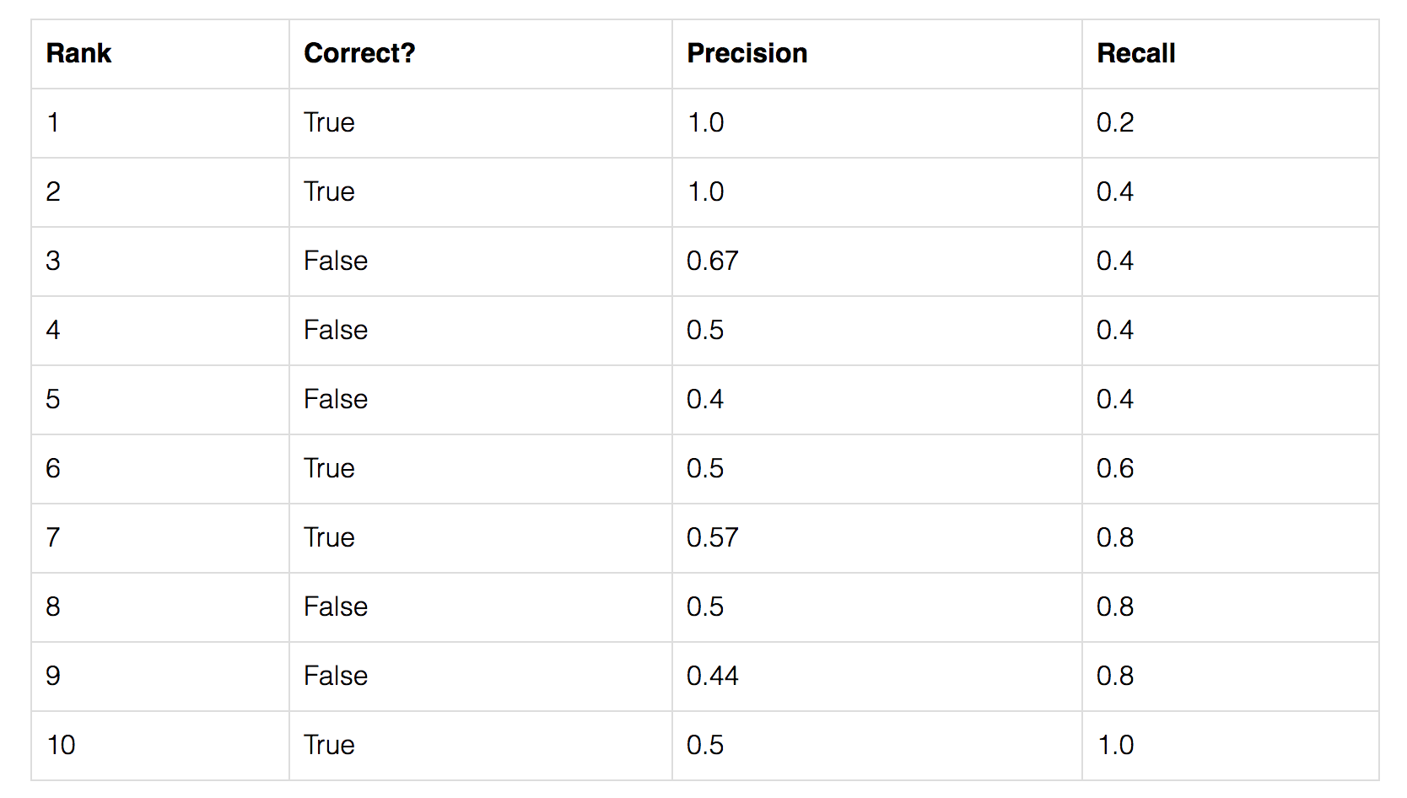
Evaluation metrics for object detection AP
Average Precision (AP) is finding the area under the precision-recall curve.
confidence
Images and notes from: https://jonathan-hui.medium.com/map-mean-average-precision-for-object-detection-45c121a31173

Slide 23
Evaluation metrics for object detection
TP?
FP?
Precision?
Recall?
Images and notes from: https://jonathan-hui.medium.com/map-mean-average-precision-for-object-detection-45c121a31173

Slide 24
Evaluation metrics for object detection
TP = 1
FP = 0
Precision = 1/1
Recall = 1/5=0.2
Images and notes from: https://jonathan-hui.medium.com/map-mean-average-precision-for-object-detection-45c121a31173

Slide 25

Evaluation metrics for object detection
TP = 2
FP = 0
Precision = 2/2
Recall = 2/5=0.4
In the example, we have all the predictions for objects of a class (let’s say cat). In the dataset there are 5 cat objects, and they have all been predicted by the model (we have 5 True in the Correct? column)
TP+FN - the total number of samples that are positive (ground truth annotation)
$$recall= \frac{TP}{total positives}$$
Images and notes from: https://jonathan-hui.medium.com/map-mean-average-precision-for-object-detection-45c121a31173

Slide 26

Evaluation metrics for object detection
TP = 2
FP = 1
Precision = 2/3
Recall = 2/5=0.4
$$recall= \frac{TP}{total positives}$$
Images and notes from: https://jonathan-hui.medium.com/map-mean-average-precision-for-object-detection-45c121a31173

Slide 27
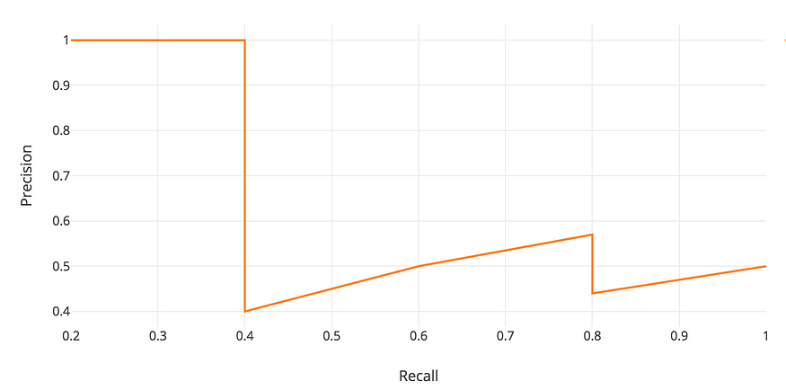
Evaluation metrics for object detection

Slide 28
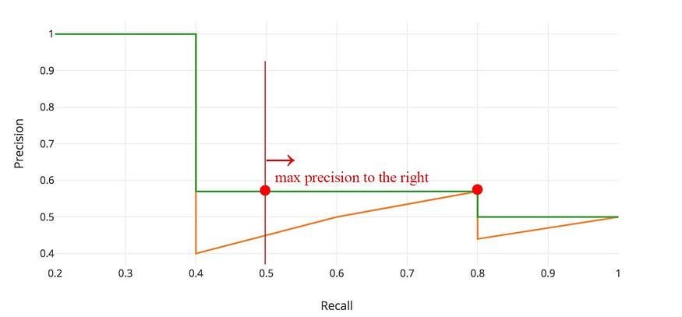
Evaluation metrics for object detection

Slide 29
Evaluation metrics for object detection
For “COCO mAP”: Compute mAP@thresh for each IoU threshold (0.5, 0.55, 0.6, …, 0.95) and take average

Slide 30
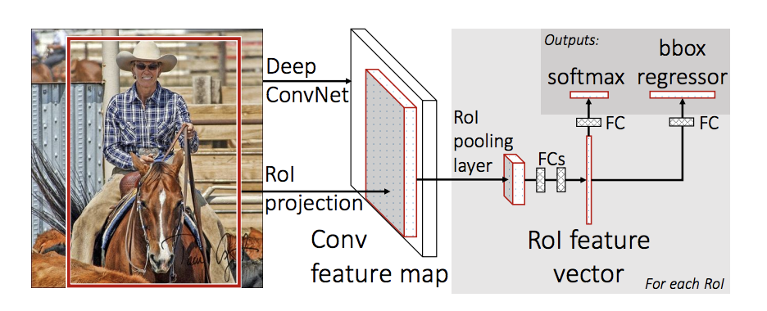
Fast RCNN
Idea: feed to image only once to the CNN to extract a feature map, then crop and warp regions of this feature map

Slide 31
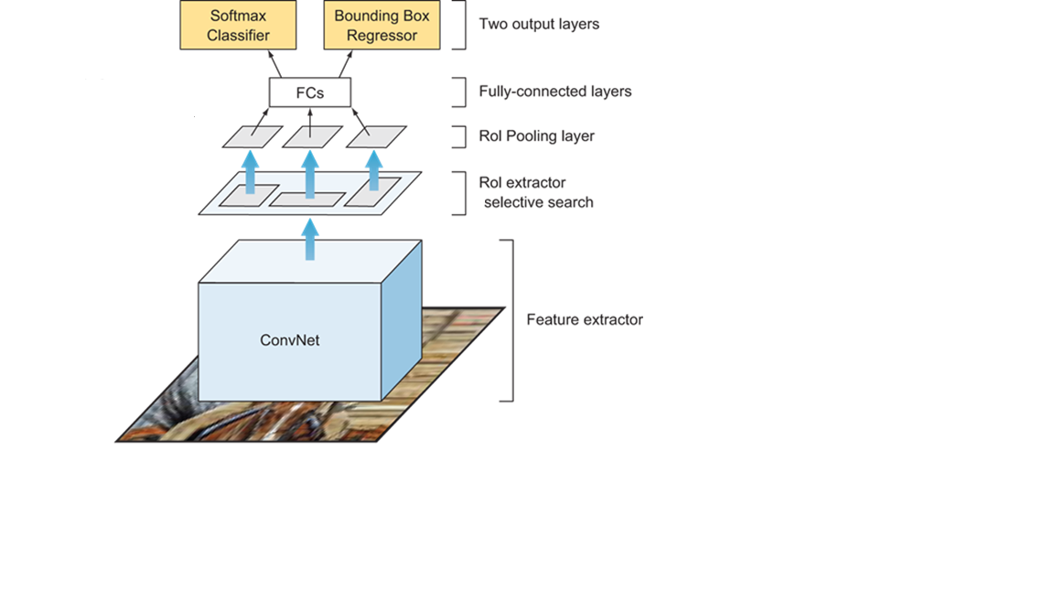
Fast R-CNN
Feed the ENTIRE image only once though the CONV net

Slide 32
Projecting points and boxes
Receptive fields
Moving one unit in the output space also moves the receptive field by one
There is a correspondence between the coordinate system of the input and the coordinate system of the output

Slide 33
Fast R-CNN
Extract the ROIs (proposed by selective search) at feature map level using RoI Pooling

Slide 34
Fast R-CNN
N classes + background
Bounding boxes
(x, y, w, h)
Extract the ROIs (proposed by selective search) at feature map level using RoI Pooling
Feed the ENTIRE image only once though the CONV net

Slide 35
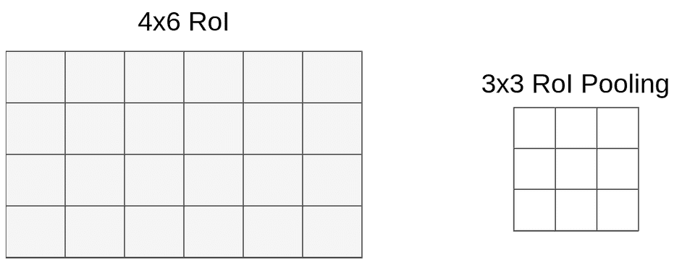
Roi Pooling
“Snap” to grid cells
Divide the H × W ROI window into an h × w grid of sub-windows of approximate size H/h × W/w and then max-pooling the values in each sub-window into the corresponding output grid cell.

Slide 36
Roi Pooling
W = 6, H = 4
w = 3, h = 3
sz_w = 6/3=2, sz_h=4/3 = 1

Slide 37
Roi Pooling
W = 6, H = 4
w = 3, h = 3
sz_w = 6/3=2, sz_h=4/3 = 1
Apply max pooling in each ROI

Slide 38
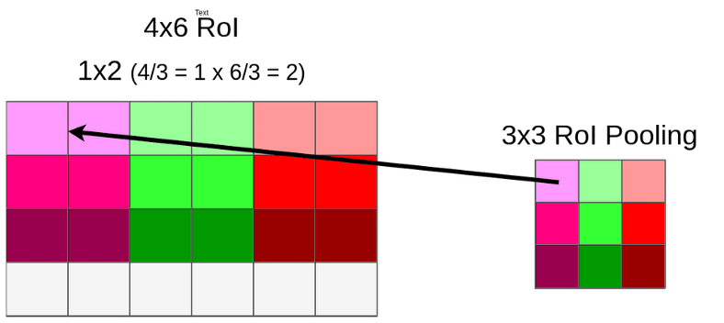
ROI Pooling example
https://towardsdatascience.com/understanding-region-of-interest-part-2-roi-align-and-roi-warp-f795196fc193
https://towardsdatascience.com/understanding-region-of-interest-part-1-roi-pooling-e4f5dd65bb44

Slide 39
ROI Pooling
Region features always the same size even if input regions have different sizes!

Slide 40
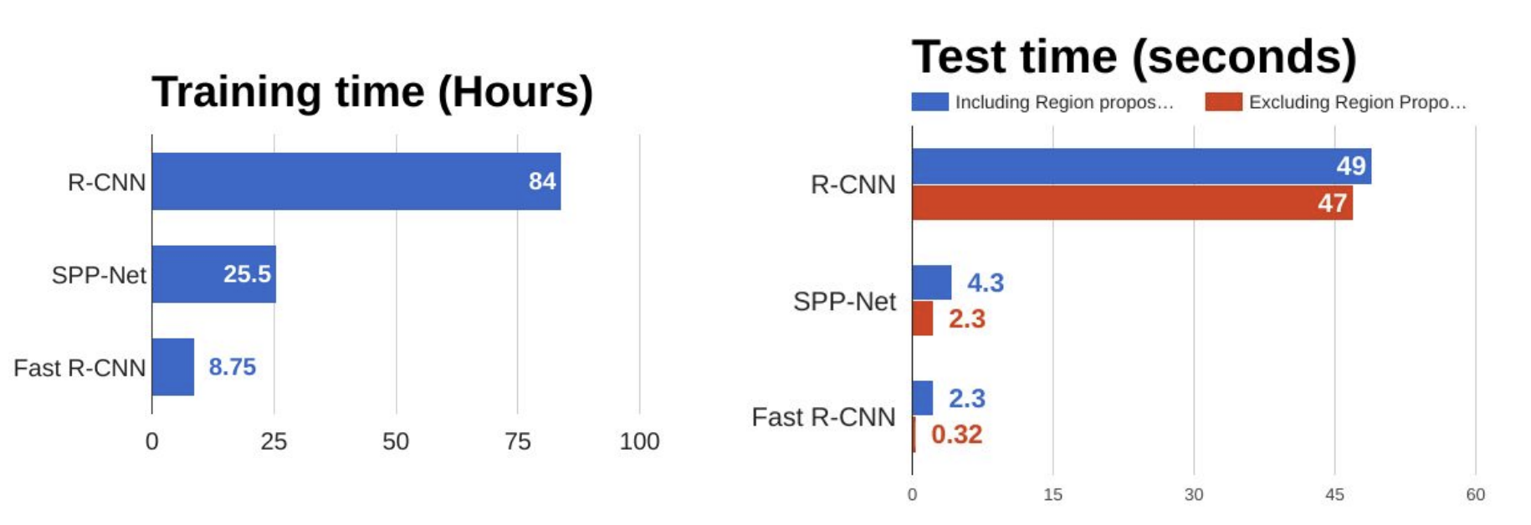
Fast RCNN
What is the most time consuming part of Fast RCNN?

